Slide 2
Inductive Bible
Study Method

Slide 3
Welcome back to IBSM
Bite 07

Slide 4
The essentiality
of
observing

Slide 5
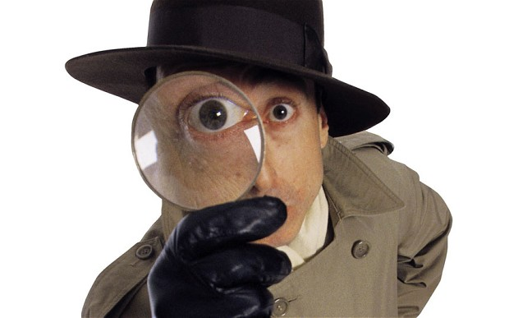
How well do you observe?

Slide 6
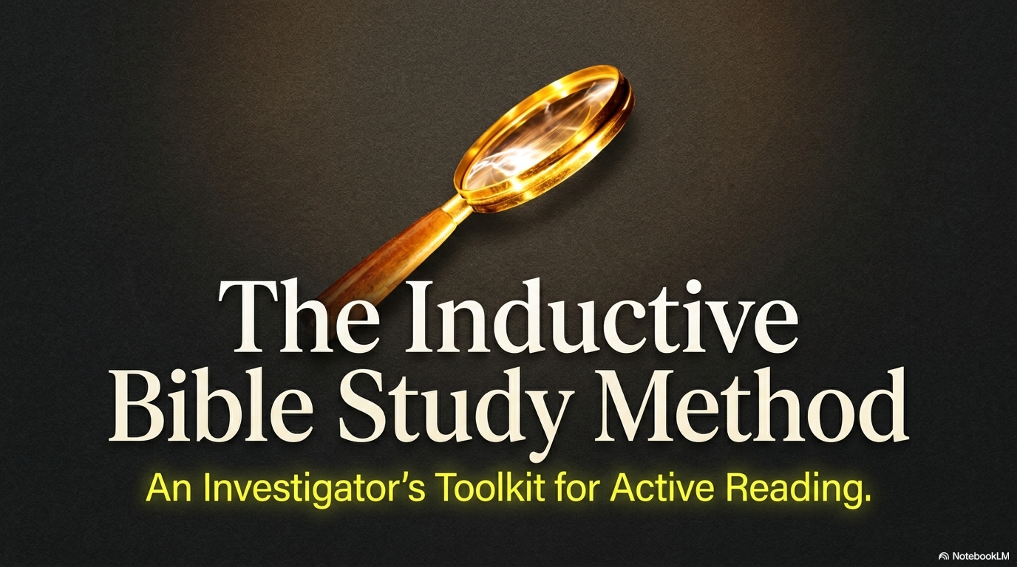

Slide 7
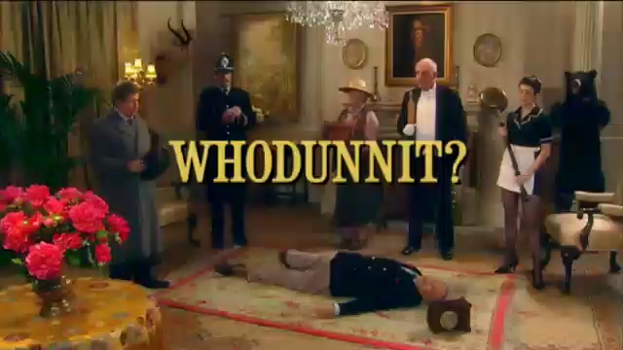

Slide 9
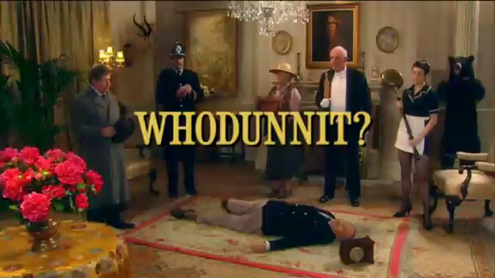

Slide 10
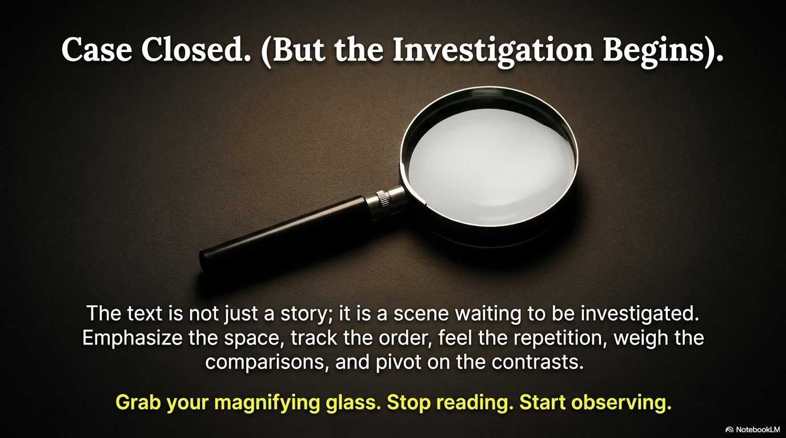

Slide 11
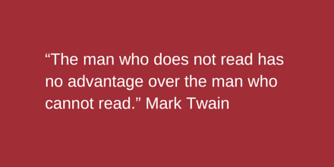

Slide 12
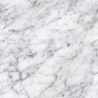
Implication
If you do not read,
you are in the same position
as someone
who does not know how to read.
You are as good as an illiterate person.

Slide 13
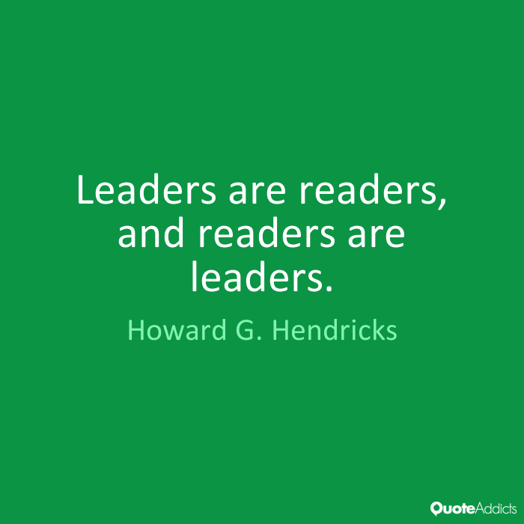

Slide 14
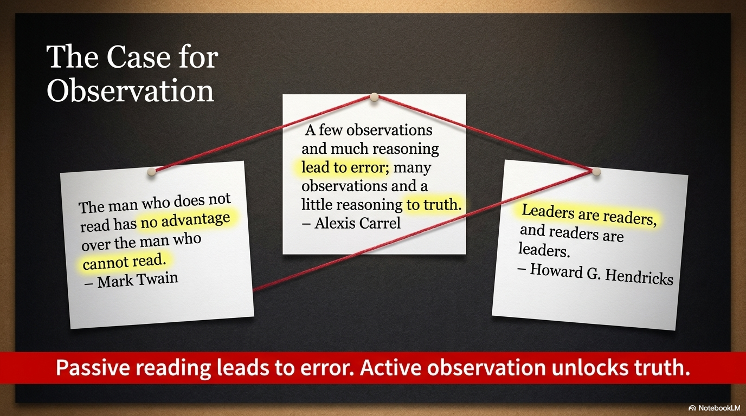

Slide 15

Success in Anything

Slide 16

If you are not a reader, get started!

Slide 17
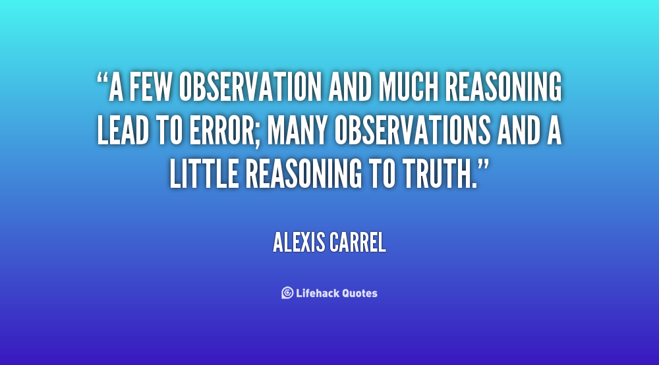
Read to Observe

Slide 18

Look for things that are
Emphasized

Slide 19
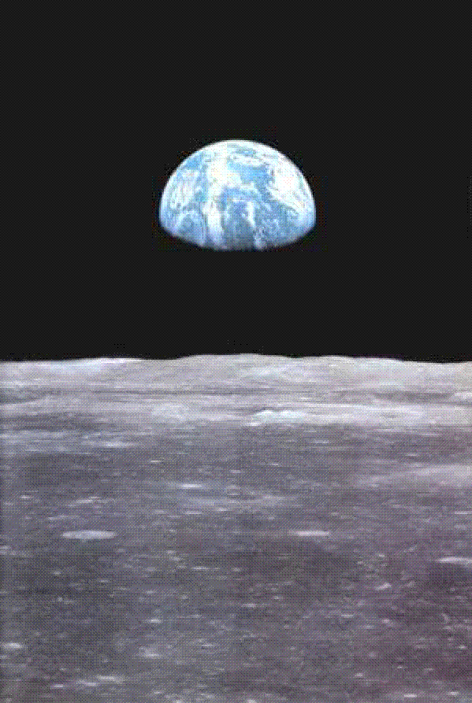
Space

Slide 20

Look for
i. Amount
of space
given

Slide 21
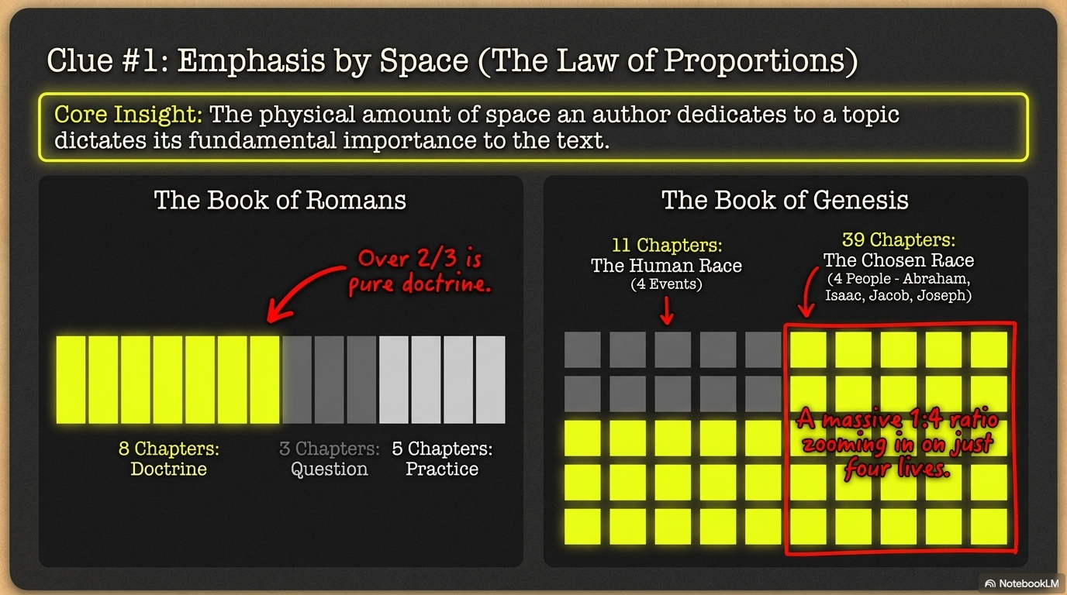

Slide 22

Romans
Theology
Apologetics
Application
THEME
CONCL
1:18-8:39
9-11
1:1-17
12-16:20
16:21-27

Slide 23
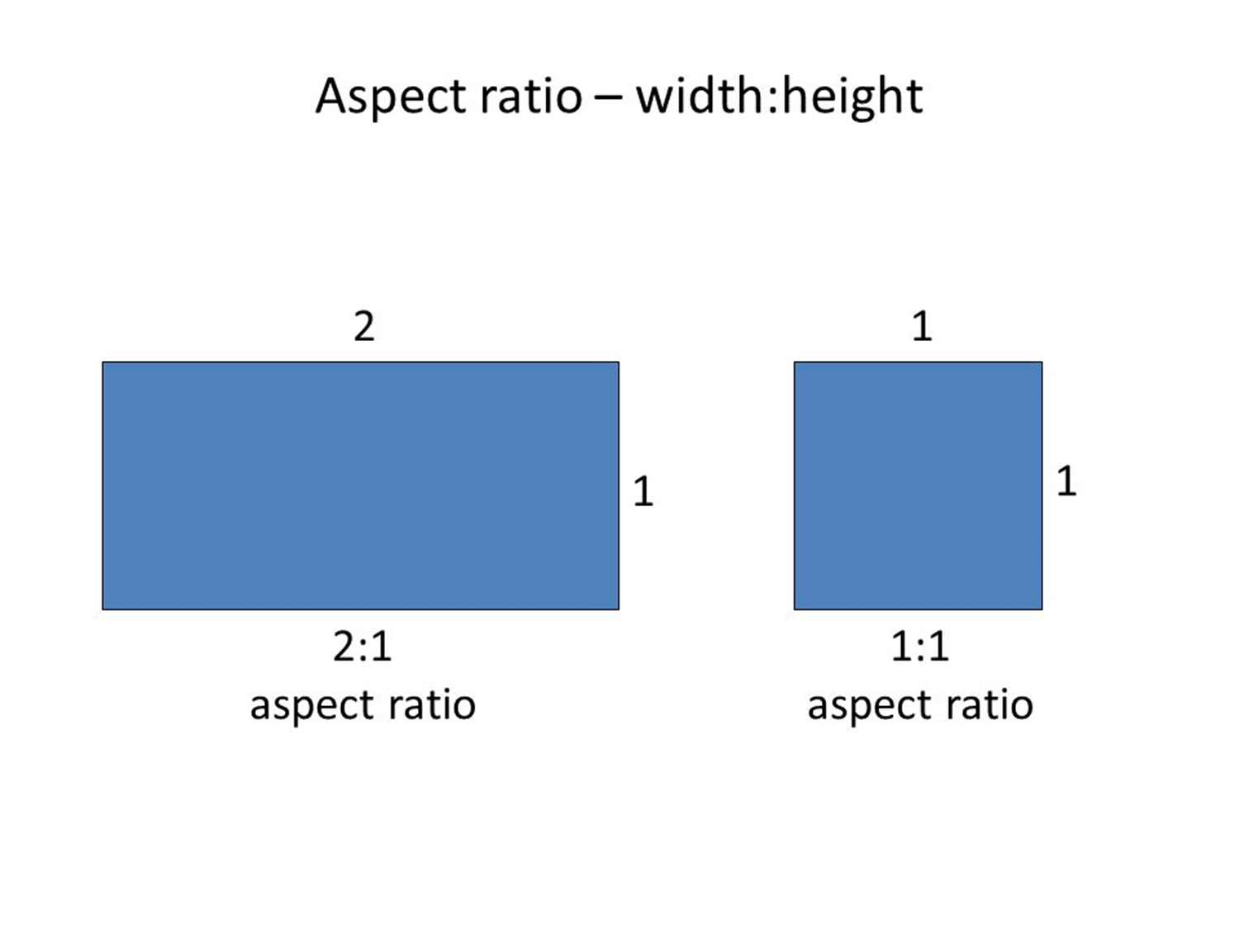
Example:
Book of Romans: 8 chapters of doctrine
3 chapters for 1 question
5 chapters of practice.
Conclusion: More than two thirds of Romans is about doctrine.

Slide 24

Genesis

Slide 25

Example:
Book of Genesis: 50 Chapters
11 chapters: Creation, Fall, Flood, & Nations
39 chapters: Abraham, Isaac, Jacob & Joseph
Ratio: 1:4
Importance of individual lives’ stories

Slide 26

Creation of the
Human Race
Chosen Race
Creation
Abraham
Fall
Isaac
Flood
Jacob
Nations
Joseph
Genesis 1-11
Genesis 12-50

Slide 27
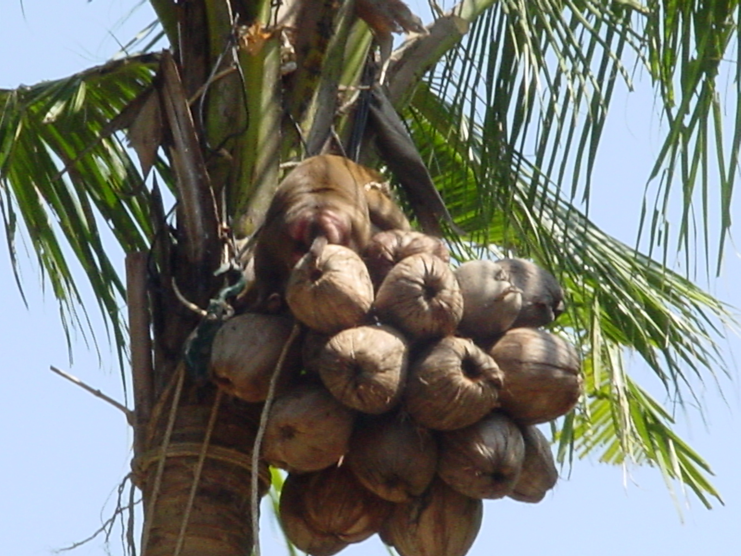
Purpose

Slide 28

Therefore many other signs Jesus also performed in the presence of the disciples, which are not written in this book; but these have been written so that you may believe that Jesus is the Christ, the Son of God; and that believing you may have life in His name.

Slide 29
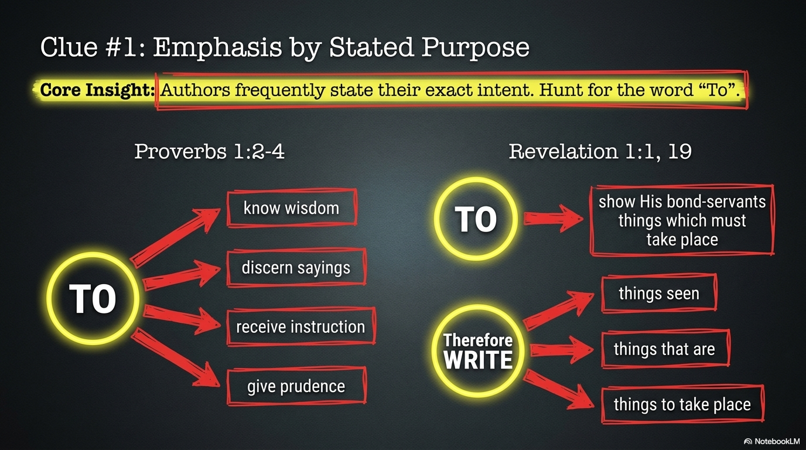

Slide 30
ii. Look for Stated Purpose
1st Example : Proverbs 1:2-4 Use of “To”
The proverbs of Solomon the son of David, king of Israel:
To know wisdom and instruction,
To discern the sayings of understanding,
To receive instruction in wise behavior,
righteousness,
justice
and equity;
To give prudence to the naive,
To the youth knowledge and discretion,

Slide 31
ii. Look For Stated Purpose
2nd Example : Rev 1:1, 19
Vs1: The Revelation of Jesus Christ,
which God gave Him
to show to His bond-servants,
the things which must soon take place;
and
He sent
and communicated it
by His angel
to His bond-servant John
Vs 19: Therefore
write the things which you have seen,
and the things which are,
and the things which will take place after these things.

Slide 32
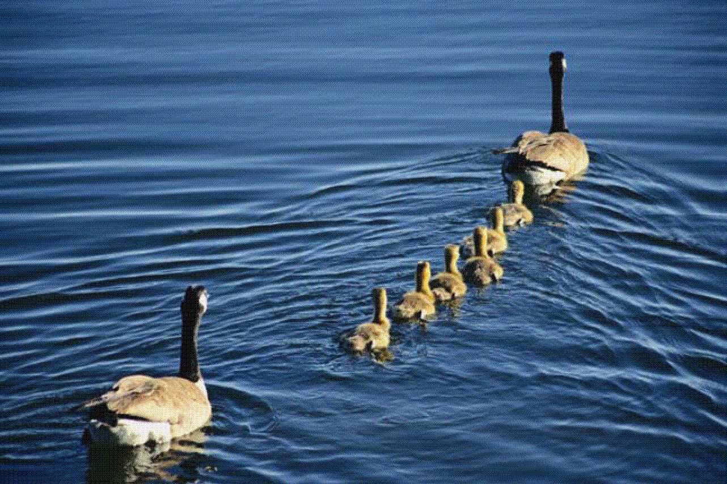
Order

Slide 33
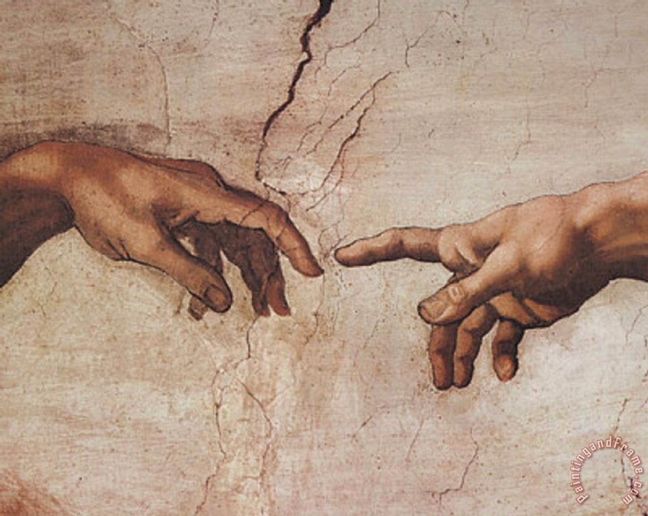
Focus of Painting

Slide 34
Equivalence
Michael Angelo planned a central theme
to his painted work of art
and gave it emphasis
by placing it
at the center of his painting.
So in studying the Bible text,
which is a literary work of art,
we can seek to look for any emphasis in the written text.

Slide 35
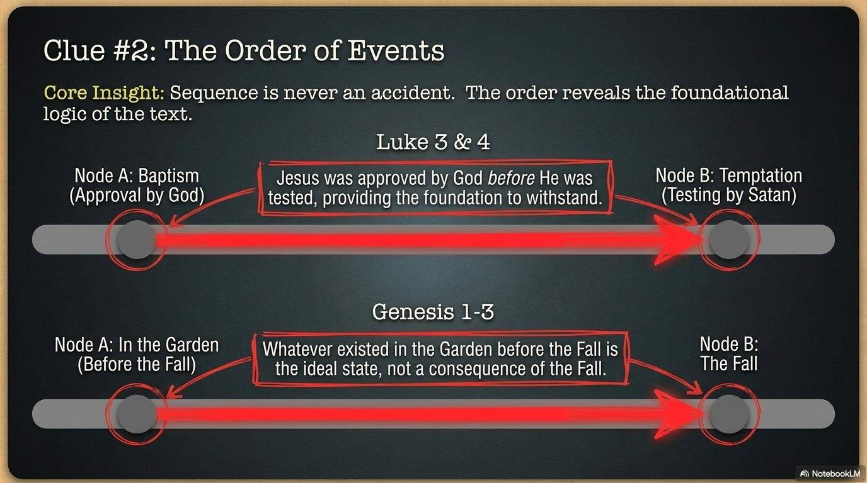

Slide 36
Luke 3
Baptism
Luke 4
Temptation

Slide 37
iii. Look for Order of events/concepts
Example: Baptism of Jesus and approval by God was before testing of Jesus by temptation from Satan (Lk 3:21-22; Lk 4)
Implication: Jesus was already approved by God before He was tested by Satan’s temptations.
Example:: Events before and after the Fall (Gen 1-3)
Implication: What is in Garden before Fall is what is not consequence of Fall.

Slide 38
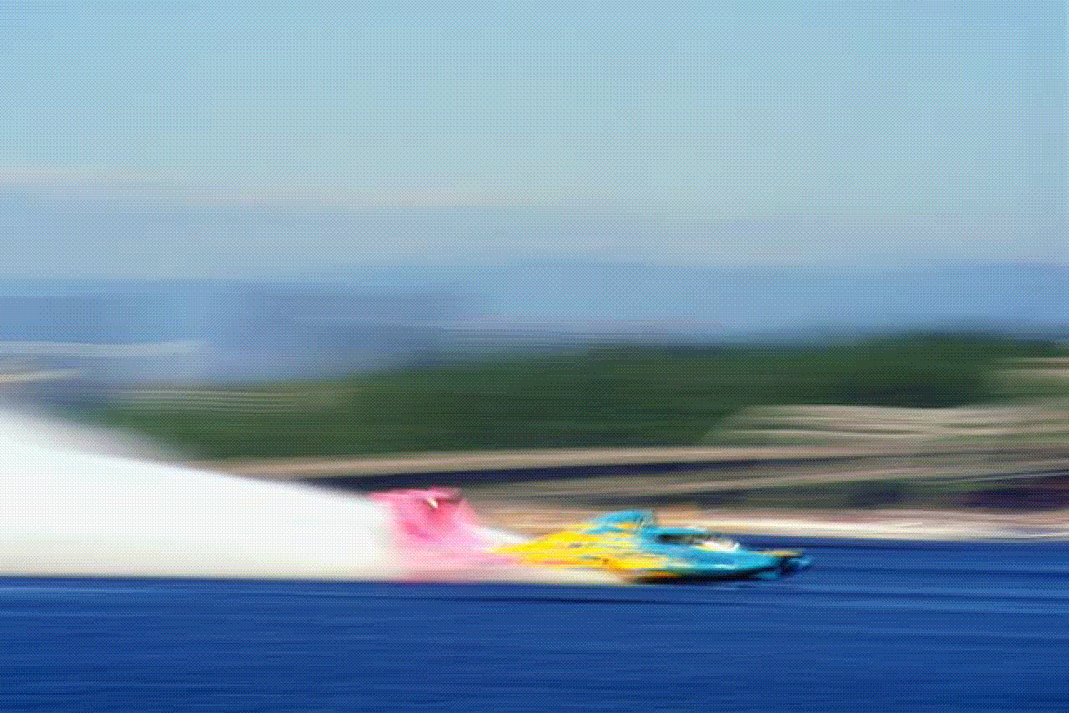
Movement

Slide 39
David's
Triumphs
Troubles
SIN
1-10
11
12-24
Obedience
Judgment

Slide 40
Look for things that are
Repeated
Repeated
Repeated

Slide 41
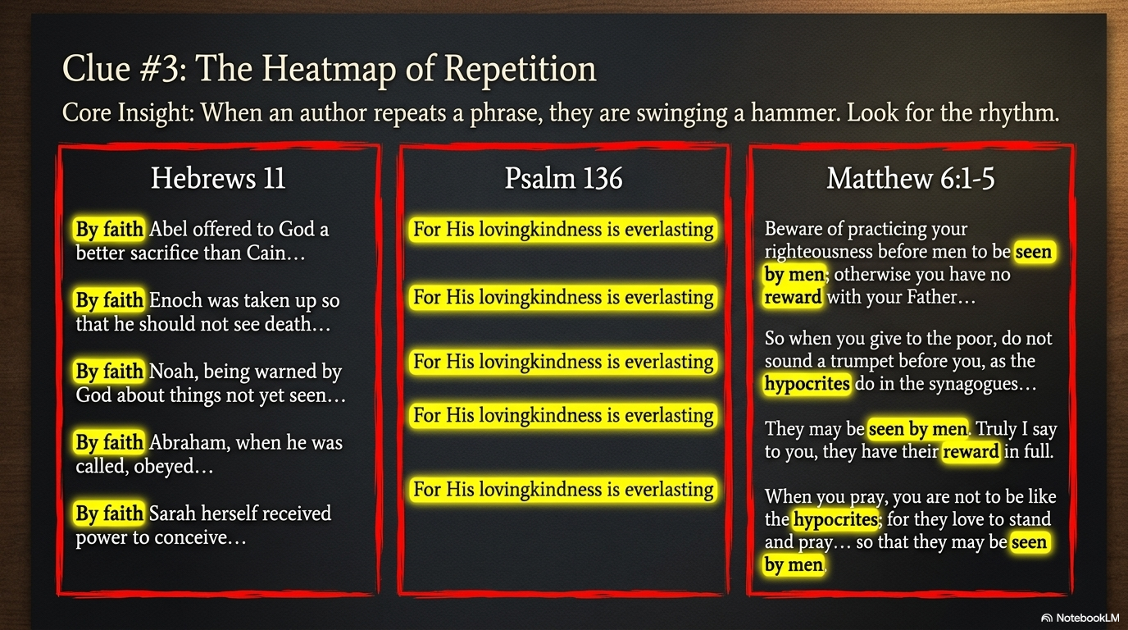

Slide 42
1 Now faith is
2 For by it
3 By faith we understand
4 By faith Abel
5 By faith Enoch
6 And without faith
7 By faith Noah,
8 By faith Abraham,
9 By faith he
11 By faith even Sarah
Hebrews 11:1-11

Slide 43

1 Give thanks to the Lord, for He is good;
For His lovingkindness is everlasting.
2 Give thanks to the God of gods,
For His lovingkindness is everlasting.
3 Give thanks to the Lord of lords,
For His lovingkindness is everlasting.
4 To Him who alone does great wonders,
For His lovingkindness is everlasting;
5 To Him who made the heavens with skill, For His lovingkindness is everlasting;
Psalm 136:1-5

Slide 44
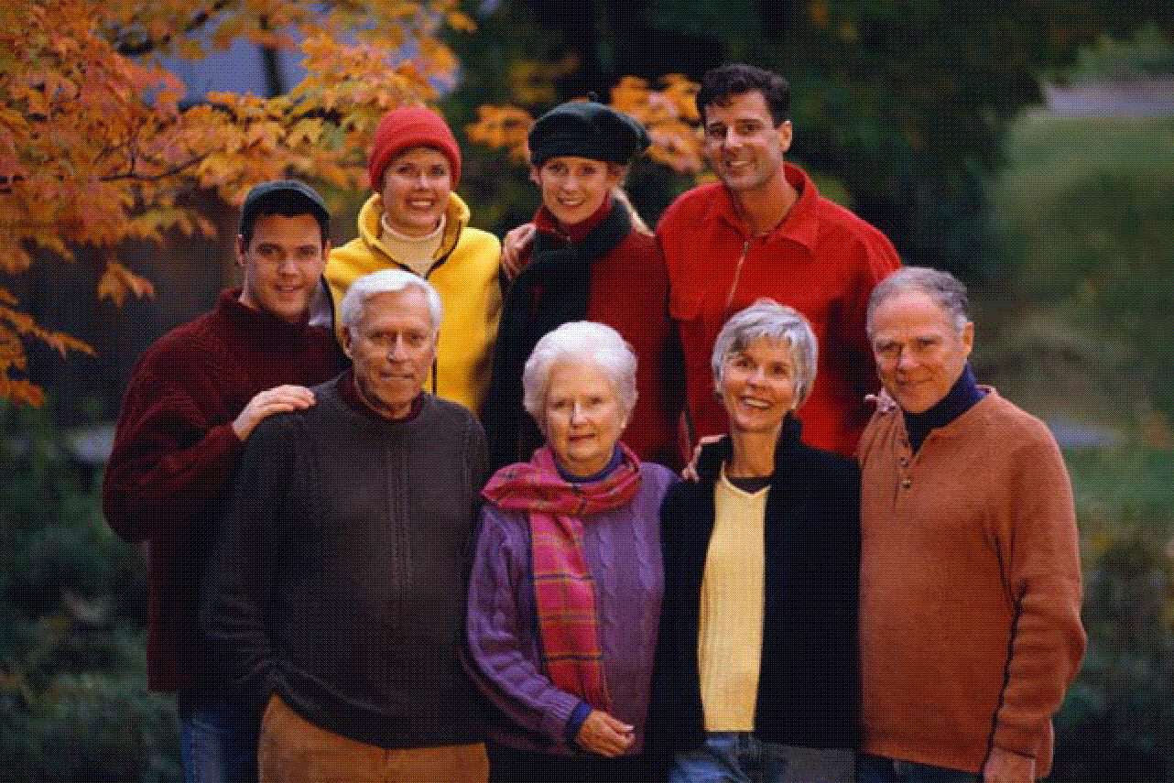
Look for things that are
Related

Slide 45
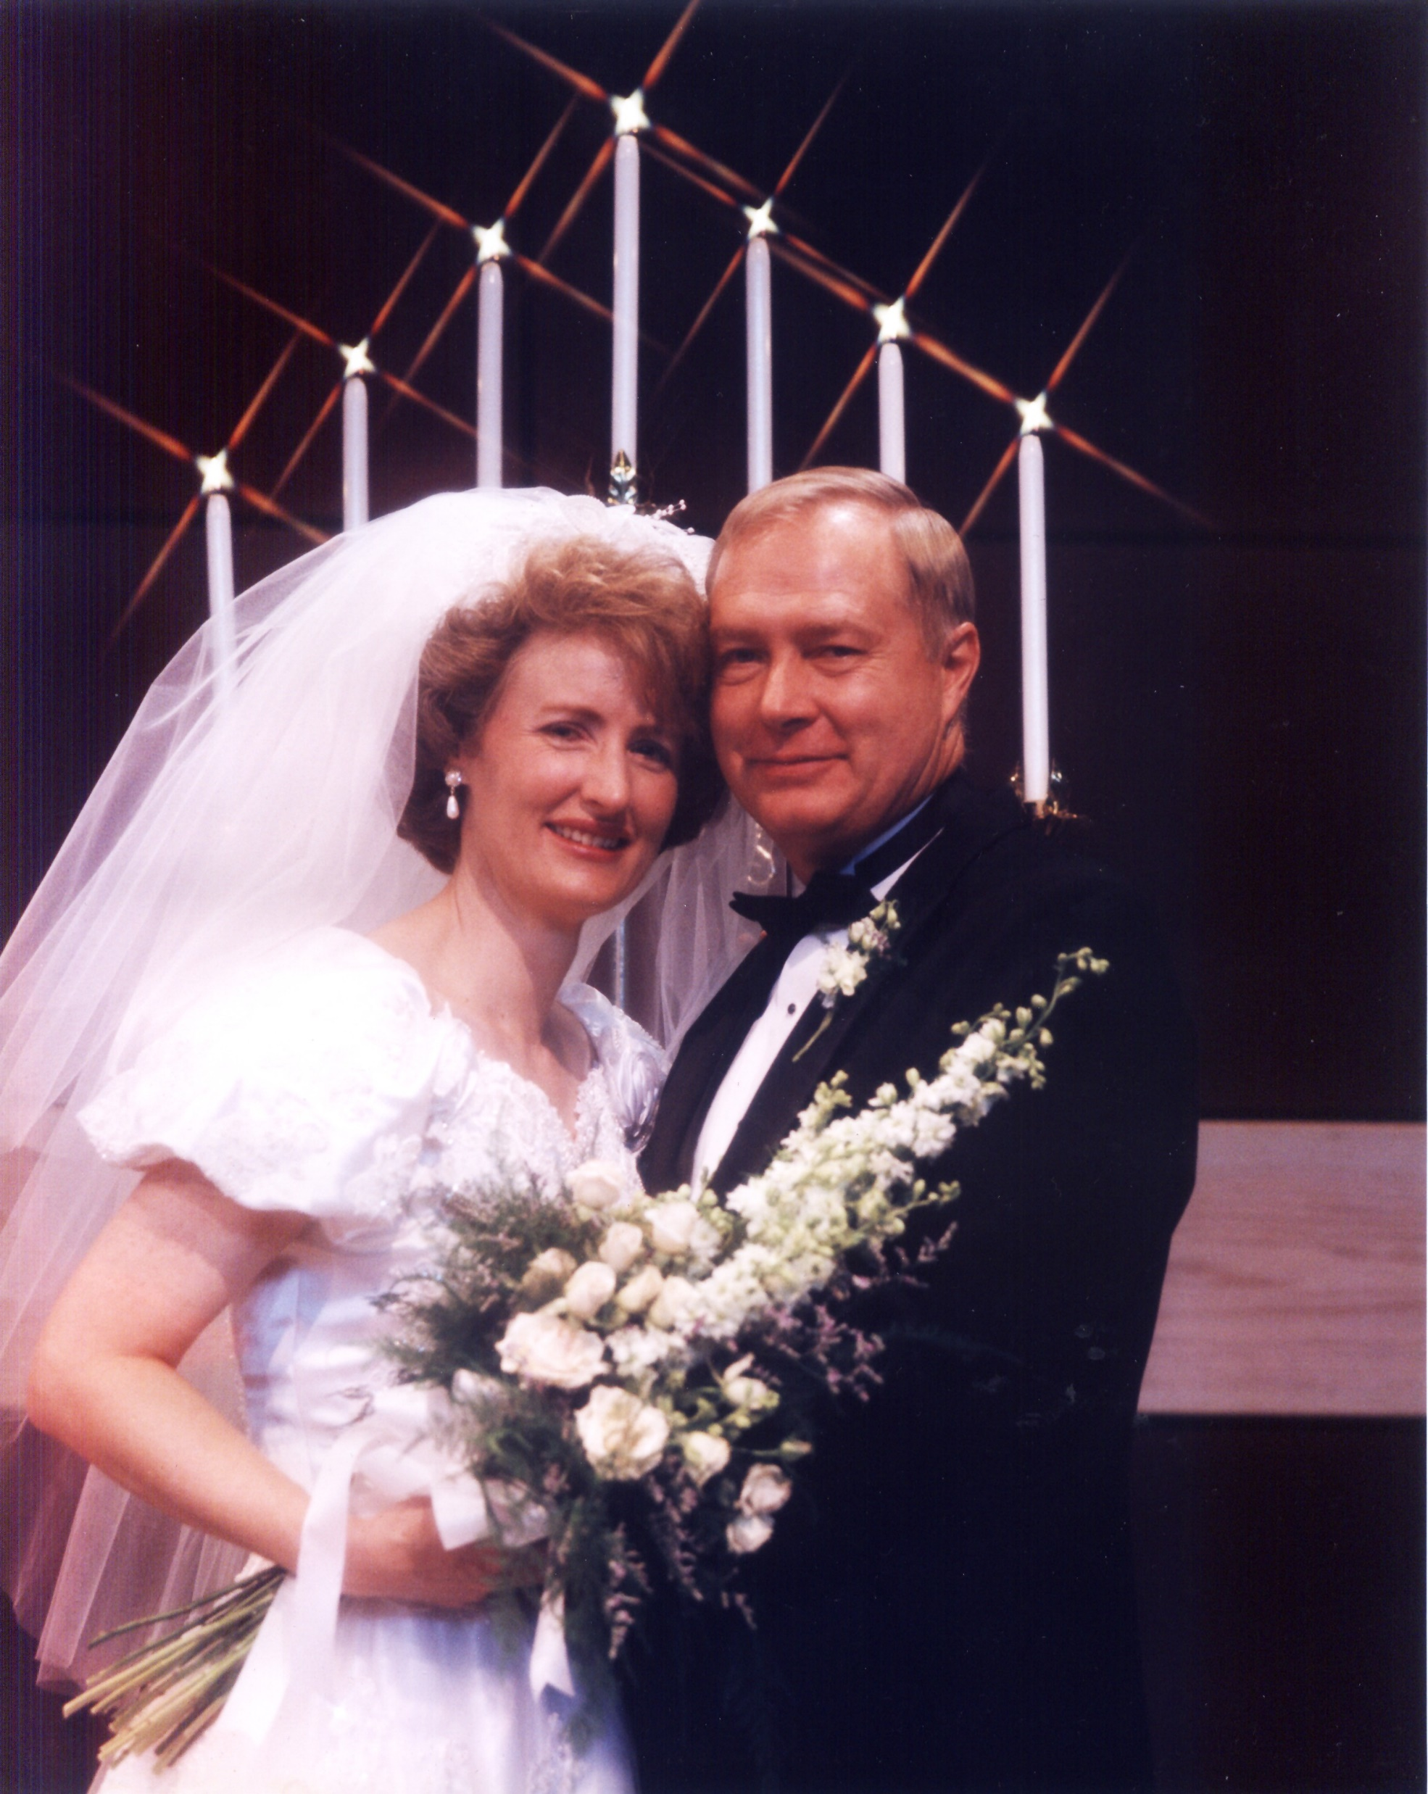

Slide 46
1 Beware of practicing your righteousness before men to be noticed by them; otherwise you have no reward with your Father who is in heaven.
2 When therefore you give alms, do not sound a trumpet before you, as the hypocrites do in the synagogues and in the streets, that they may be honored by men. Truly I say to you, they have their reward in full. 3 But when you give alms, do not let your left hand know what your right hand is doing 4 that your alms may be in secret; and your Father who sees in secret will repay you.
5 And when you pray, you are not to be as the hypocrites; for they love to stand and pray in the synagogues and on the street corners, in order to be seen by men. Truly I say to you, they have their reward in full.
Matthew 6:1-5

Slide 47
What shall we say then? Are we to continue in sin that grace might increase? May it never be! How shall we who died to sin still live in it?
What then? Shall we sin because we are not under law but under grace? May it never be! Do you not know that when you present yourselves to someone as slaves for obedience, you are slaves of the one whom you obey, either of sin resulting in death, or of obedience resulting in righteousness?
Romans 6:1-2, 15-16

Slide 48
And Saul was in hearty agreement with putting him to death.
And on that day a great persecution arose against the church in Jerusalem; and they were all scattered throughout the regions of Judea and Samaria, except the apostles. And some devout men buried Stephen, and made loud lamentation over him. But Saul began ravaging the church, entering house after house; and dragging off men and women, he would put them in prison.
Acts 8:1-4

Slide 49
Therefore, those who had been scattered went about preaching the word. And Philip went down to the city of Samaria and began proclaiming Christ to them. And the multitudes with one accord were giving attention to what was said by Philip, as they heard and saw the signs which he was performing.

Slide 50
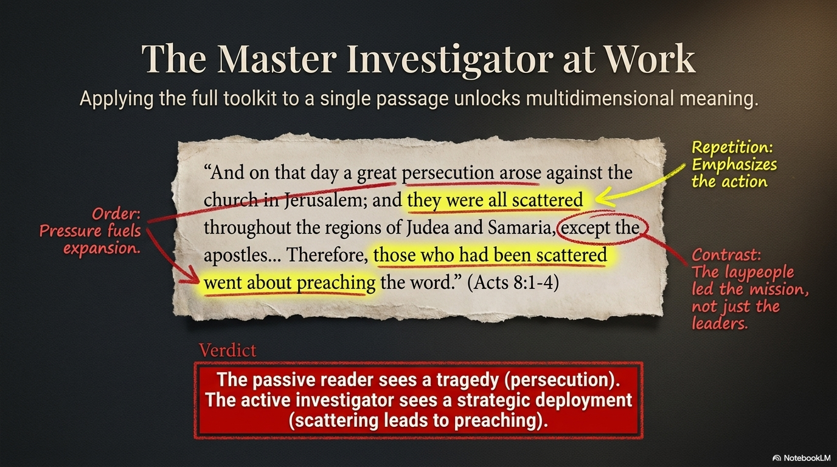

Slide 51
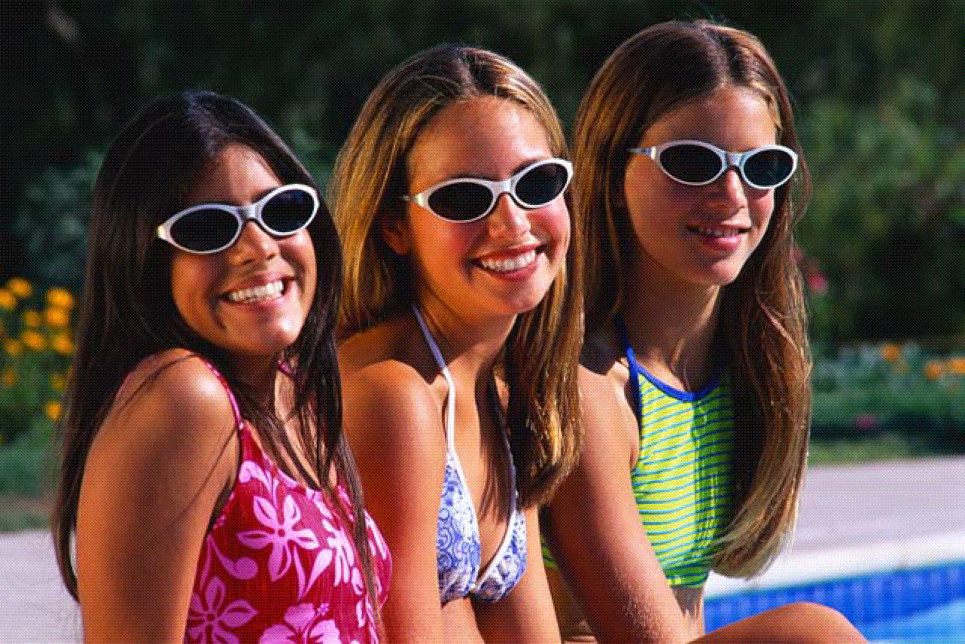
Look for things that are
Alike

Slide 52
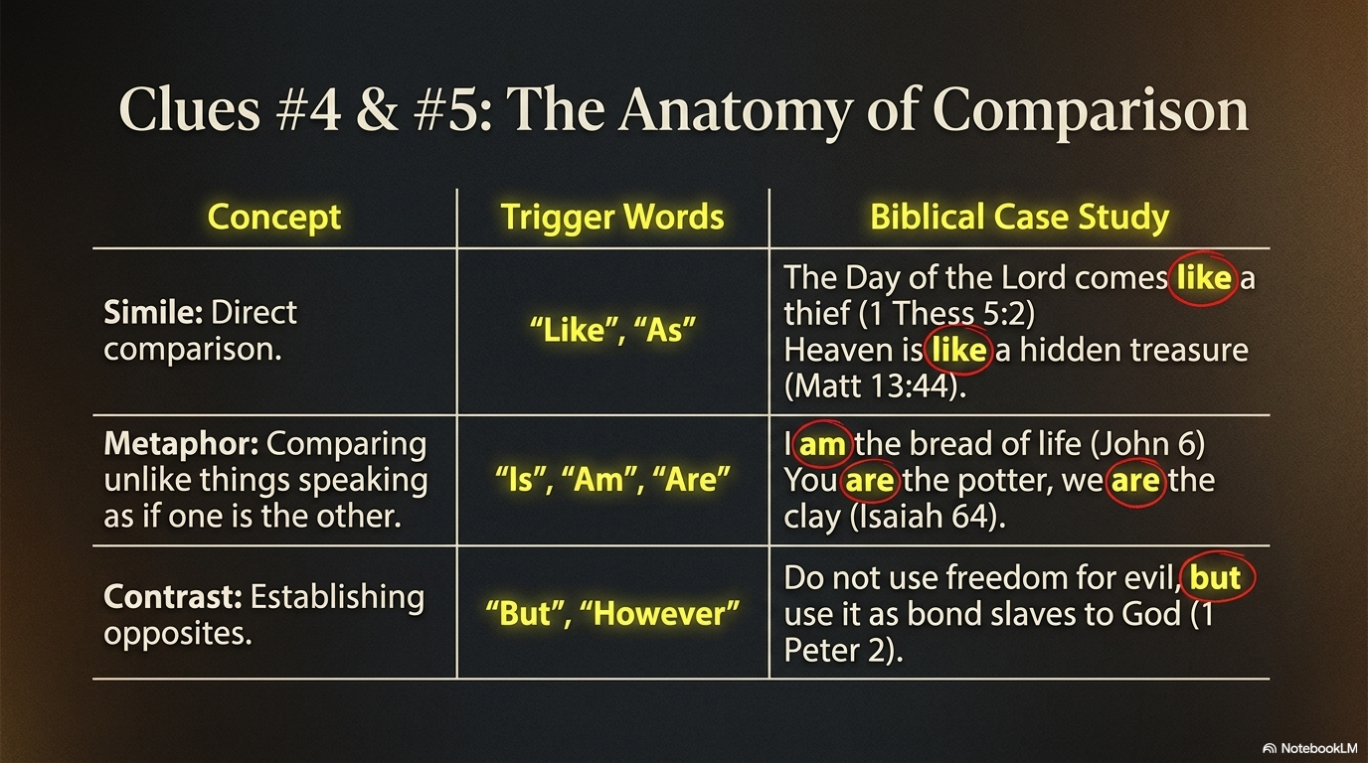

Slide 53
4. Look for Things that are Alike
Similes
A simile is a figure of speech
that makes a direct comparison,
showing similarities
between two different things
with the help of the words
“like” or “as”.

Slide 54
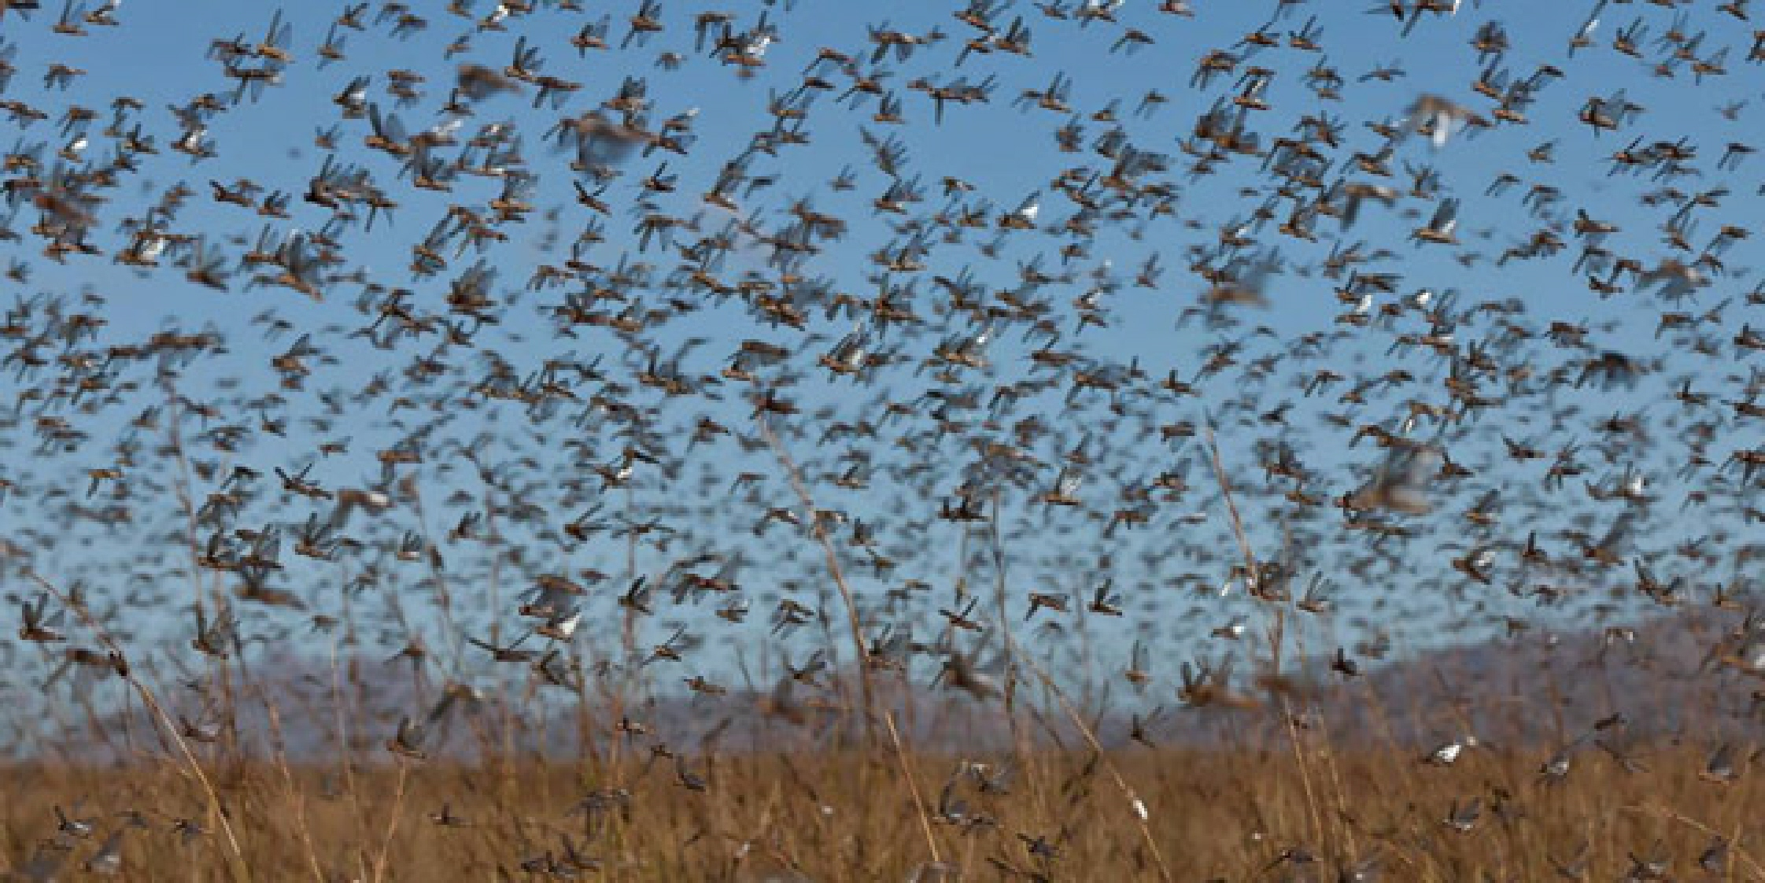
Example of use of ‘like’
They came up with their livestock
and their tents
like swarms of locusts.

Slide 55
The enemies of Israel were compared to destructive locusts
“For they would come up with their livestock
and their tents,
they would come in like locusts for number,
both they and their camels were innumerable; and they came into the land to devastate it.”
Judges 6:5
The image of locusts gives a visual example of the enemies of Israel,

Slide 56
Another Use of ‘like’
1 Thessalonians 5:2
“For you yourselves know full well that the day of the Lord will come just like a thief in the night.”
Explanation : The day of the Lord will come unexpectedly and at a time that no one is or can ever be aware of.
Matt. 13:44
The kingdom of heaven is like treasure hidden in a field.
Explanation: Heaven is compared to a hidden treasure that is very valuable, but hard to find, just like buried treasure.

Slide 57
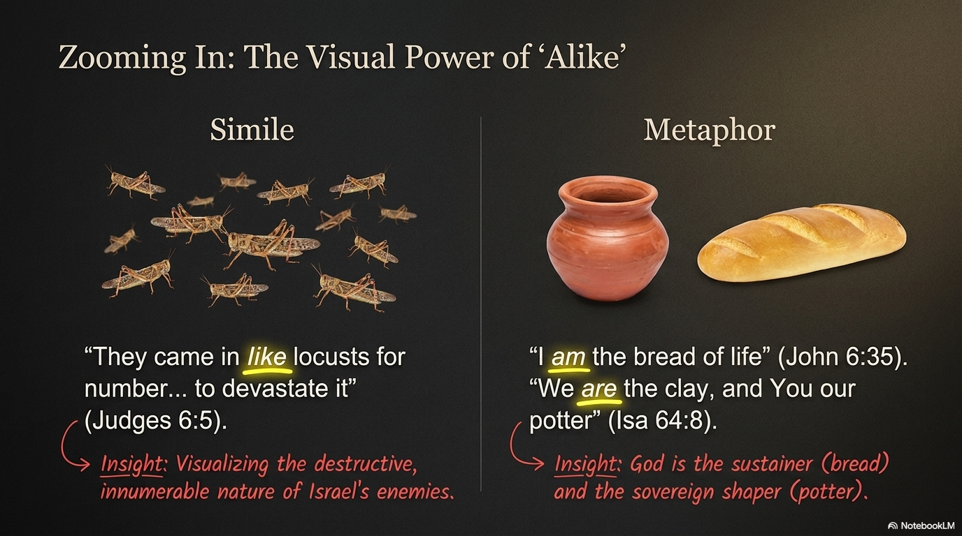

Slide 58
Example of use of ‘as’
“For as Jonah was three days and three nights
in the belly of a huge fish,
so
the Son of Man will be three days and three nights
in the heart of the earth.”
(Matt 12:40)
Explanation: Similarity between the experience of Jonah and Jesus .

Slide 59
Example of use of ‘as’
“…and he will separate the people
one from another
as a shepherd separates
the sheep from the goats.”
(Matt 25:32-33)

Slide 60
Metaphors of Similarity
A metaphor is a way of writing
that compares two unlike things
which shares the same characteristics
and speaks as if one is the other.
The helping verbs used are ‘is’, ‘am’, ‘are’ etc.

Slide 61
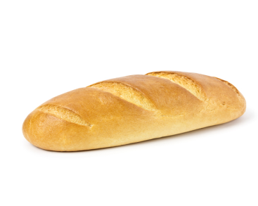
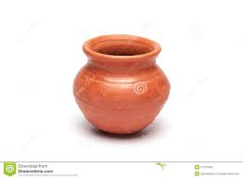
Examples of Metaphors
Isa 64:8
John 6:35
But now, O Lord,
You are our Father,
We are the clay,
and You our potter;
And all of us are
the work of Your hand
of Your hand.
Jesus said to them,
‘I am the bread of life;
he who comes to me
will not hunger,
and he who believes in me
will never thirst.’

Slide 62
Example of Metaphor
The Lord is my rock,
my fortress
and my deliverer;
my God is my rock,
in whom I take refuge,
my shield
and the horn of my salvation,
my stronghold.
Ps 18:2

Slide 63
Look for things that are
Opposite

Slide 64
5. Look for Things that are Unlike
Use of word ‘but’
Act as free men,
and
do not use your freedom
as a covering for evil,
but (do) use it (your freedom
as a covering for good)
as bond slaves of God
(words in italics not in text)
(1 Peter 2:16)

Slide 65
1 Peter 2:16
Topic is ‘your freedom’
Contrast/difference is free men and bond slaves of God
(Yet referring to the same person)
Implicit contrast is evil and good

Slide 66
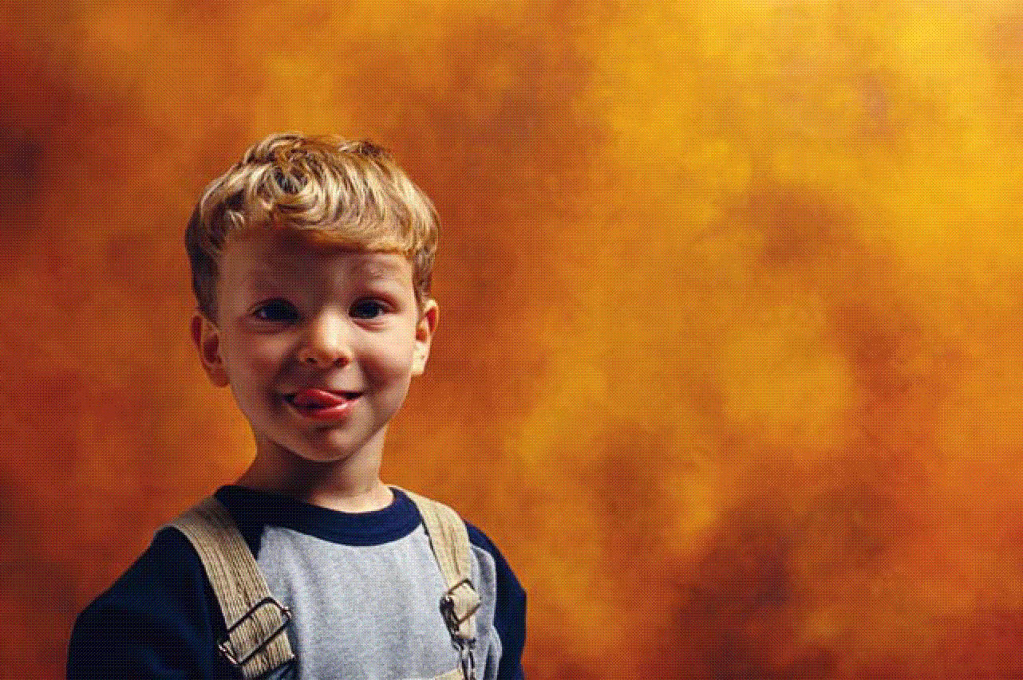
Look for things that are
True to life

Slide 67


